Slide 1
ReLU Strikes Back:
Exploiting Activation Sparsity in Large Language Models
ICLR 2024 oral accept

Slide 2
목차
Introduction
Does the Activation Function Impact Performance?
Relufication
Applications

Slide 3
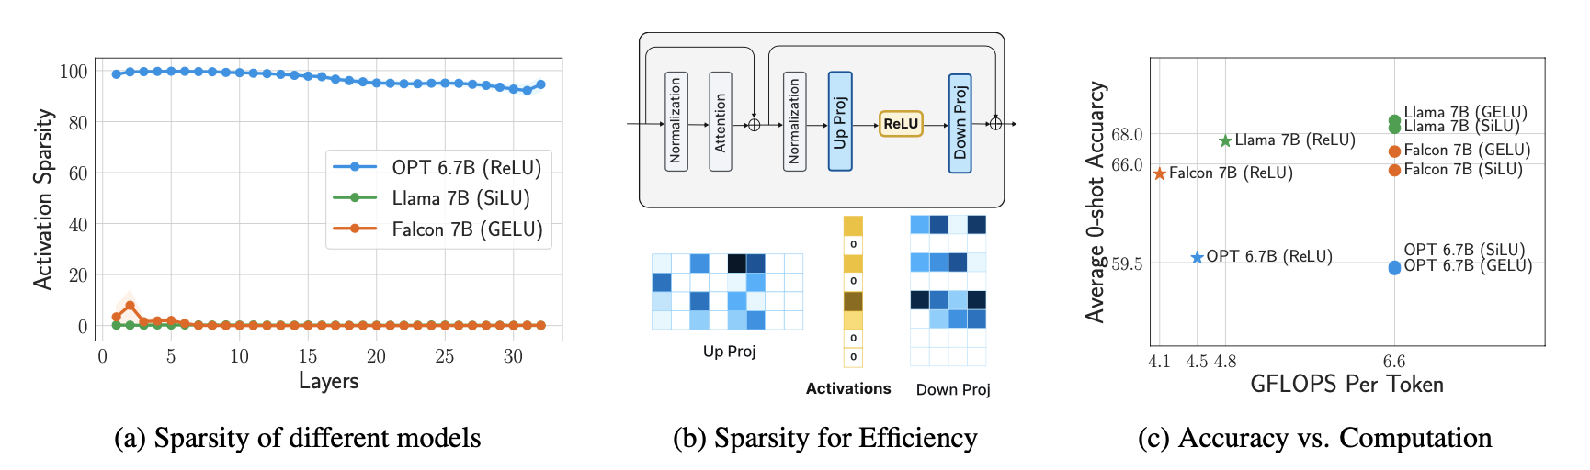
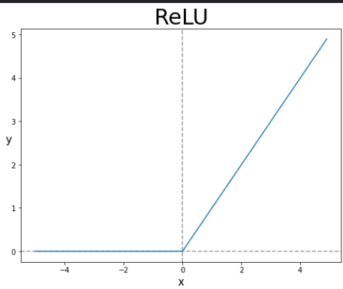
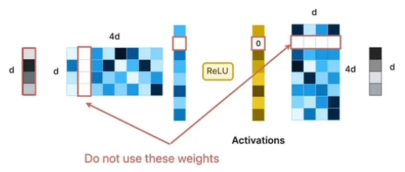
Introduction

Slide 4
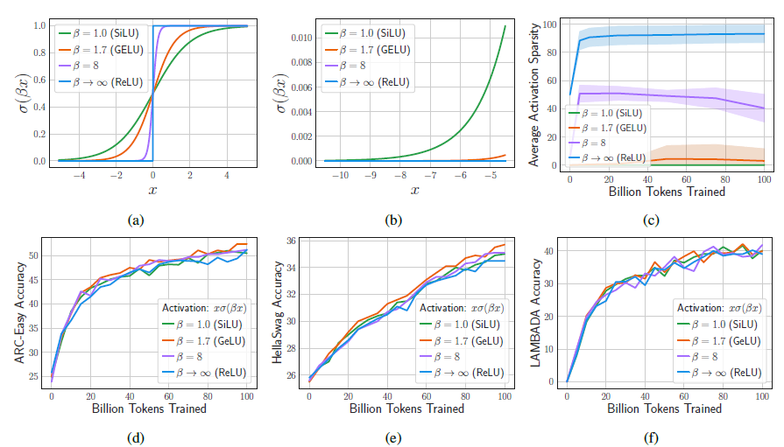
Does the Activation Function Impact Performance?

Slide 5
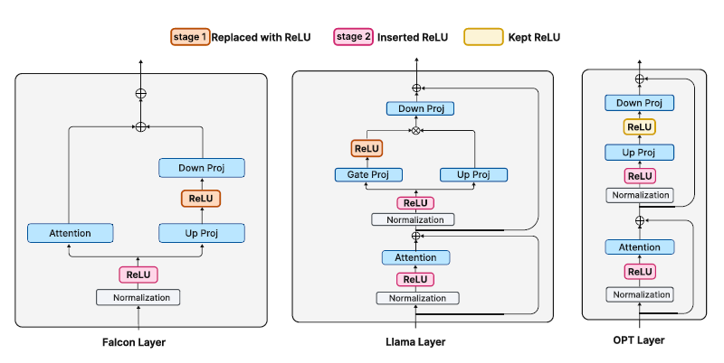
Relufication

Slide 6
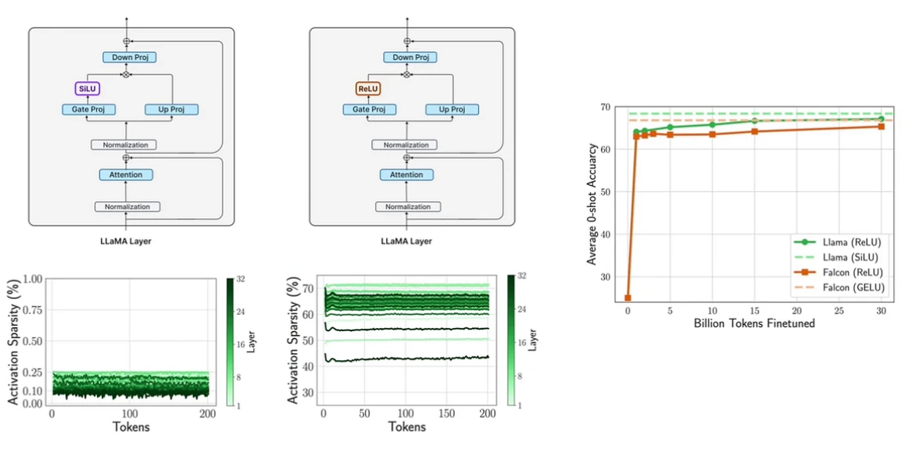
Relufication

Slide 7
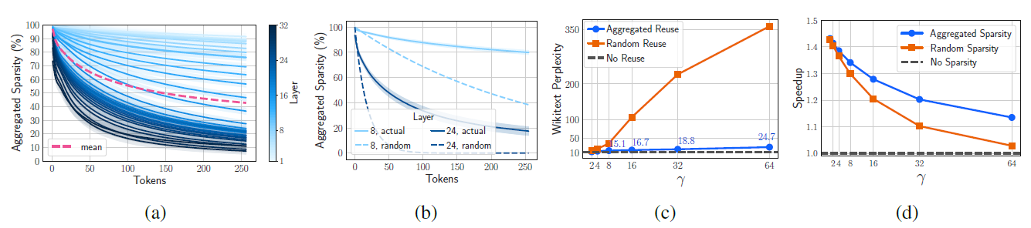
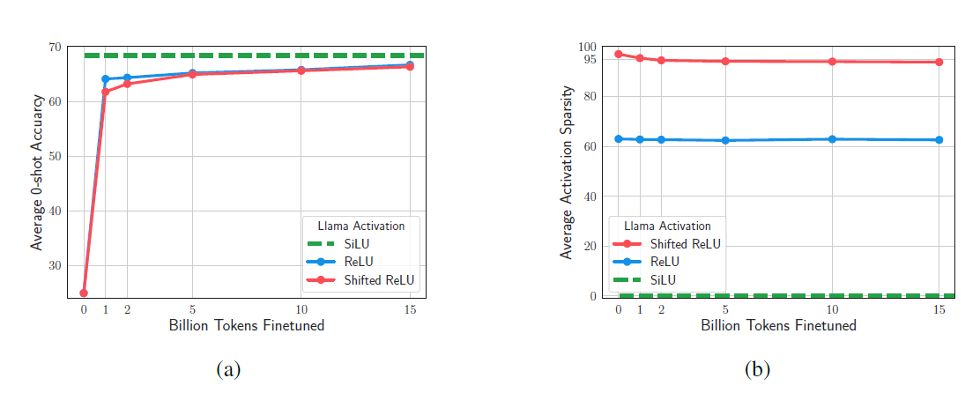
Applications

Slide 8
끝

